Slide 1
CODE BLUE: HOMELESS RESCUE INITIATIVE
Stephen Anderson, Angela Herb, Matthew Horger, Andrew Johnson and Conor Waldt

Slide 2

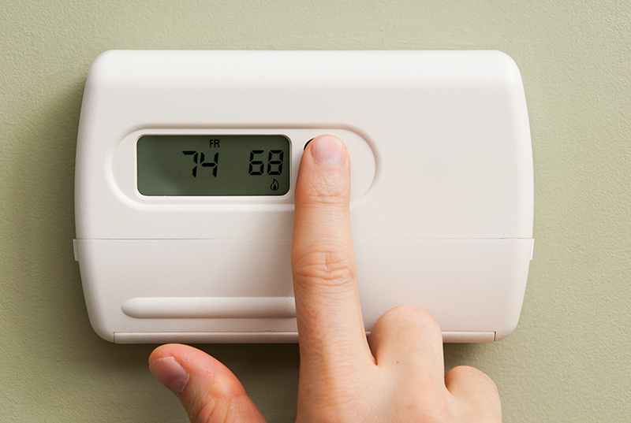

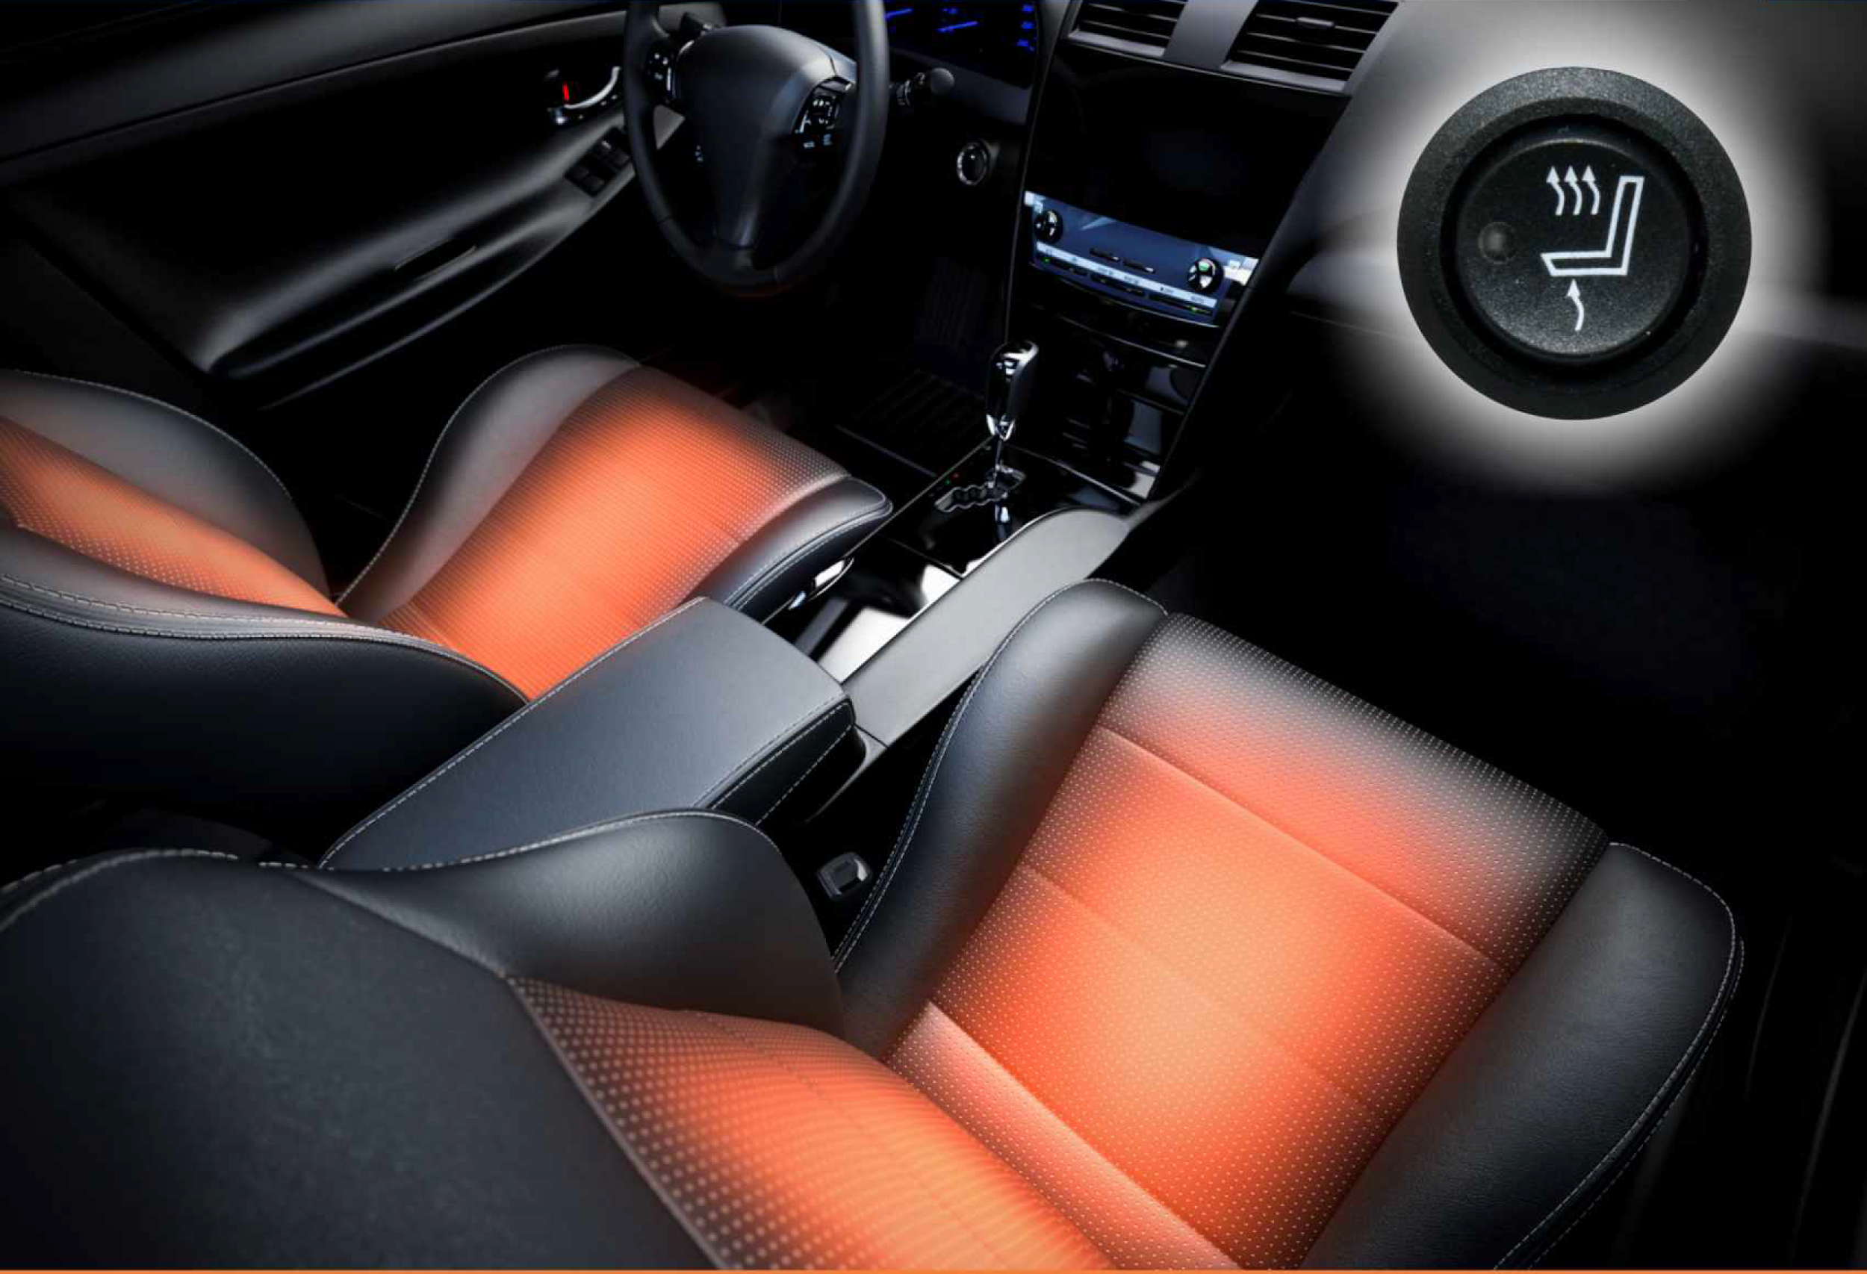

Slide 3
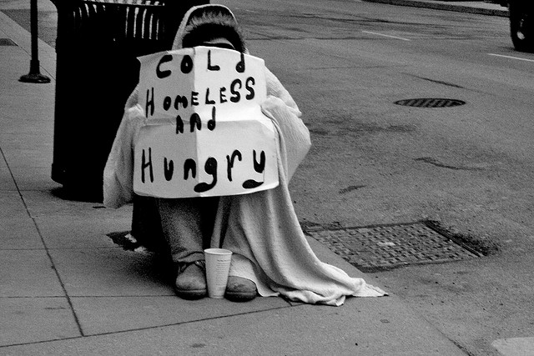
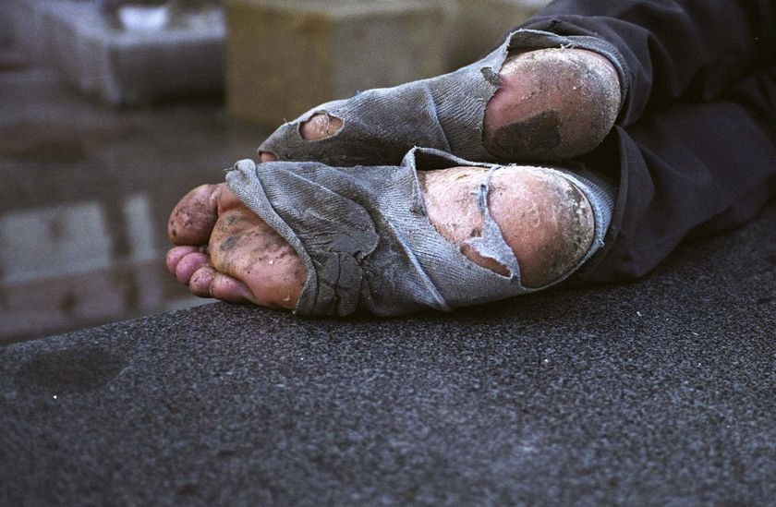
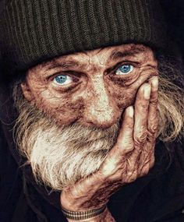
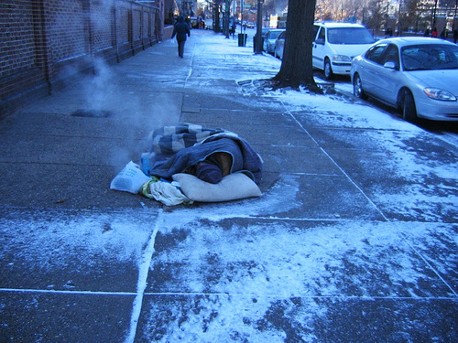

Slide 4
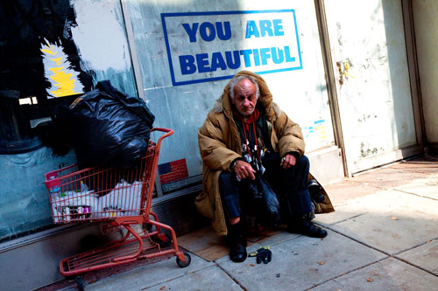
ADDRESSING COMMUNITY NEEDS
Reducing risk for homeless in cold weather
Saving the lives of the homeless
Providing effective means for enacting code blue program

Slide 5
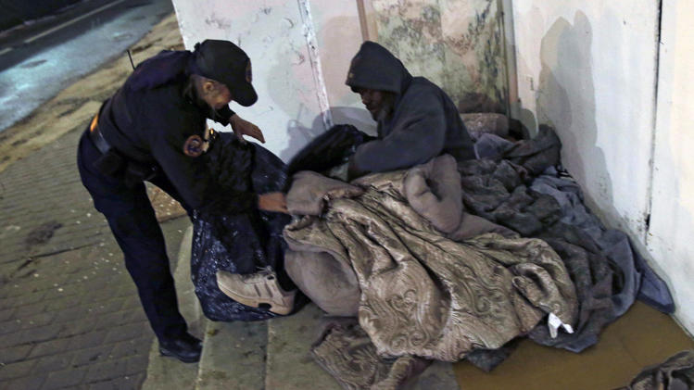
REAL WORLD PROBLEM
Major concern - finding shelter for homeless, especially in freezing conditions
Providing warmth and a place to stay for the night during the winter months is crucial for homeless shelters
Northeast and Midwest
Some homeless instead sleep outside in frigid temperatures.
Serious health risk for frostbite & hypothermia

Slide 6
PENNSYLVANIA HOMELESS STATISTICS
16,200 Pennsylvanians are known to be homeless.
School districts are faced with approximately 13,000 homeless children each year.
Philadelphia
Poverty rate of 27%, one of the highest in the nation - results in a high density homeless population in the city
estimated 650 people are homeless at any given time.
Pennsylvania - ranked 28 out of 50 in the U.S. in terms of homeless persons
Roughly 120 out of 100,000 people are homeless.

Slide 7
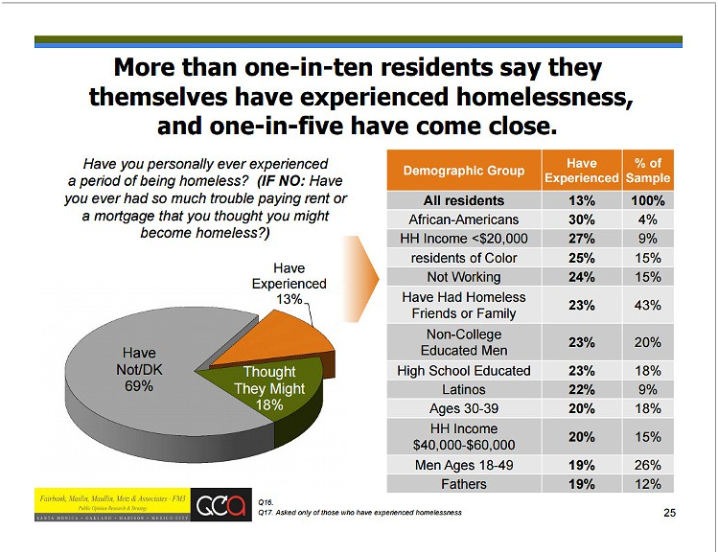

Slide 8
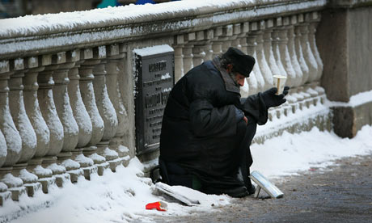
THE BASICS: HOMELESS IN THE COLD
Risks of Hypothermia
occurs when core body temperature drops below 95°
caused by prolonged exposure to cold
lost to environment
lost to cold surfaces (ground)
wind - breaks warm barrier over skin
heart, nervous, and organ systems stop functioning
can lead to irreparable damage or death

Slide 9

PRECEDENT – THE CODE BLUE INITIATIVE
Code Blue:
Can occur from December - March
This alert is announced when the National Weather Bureau predicts below freezing temperatures or wind chills less than 20°F.
Code Grey
The OSH may issue this during high winds, heavy rain, or frozen precipitation when the temperature is above 32°F.

Slide 10
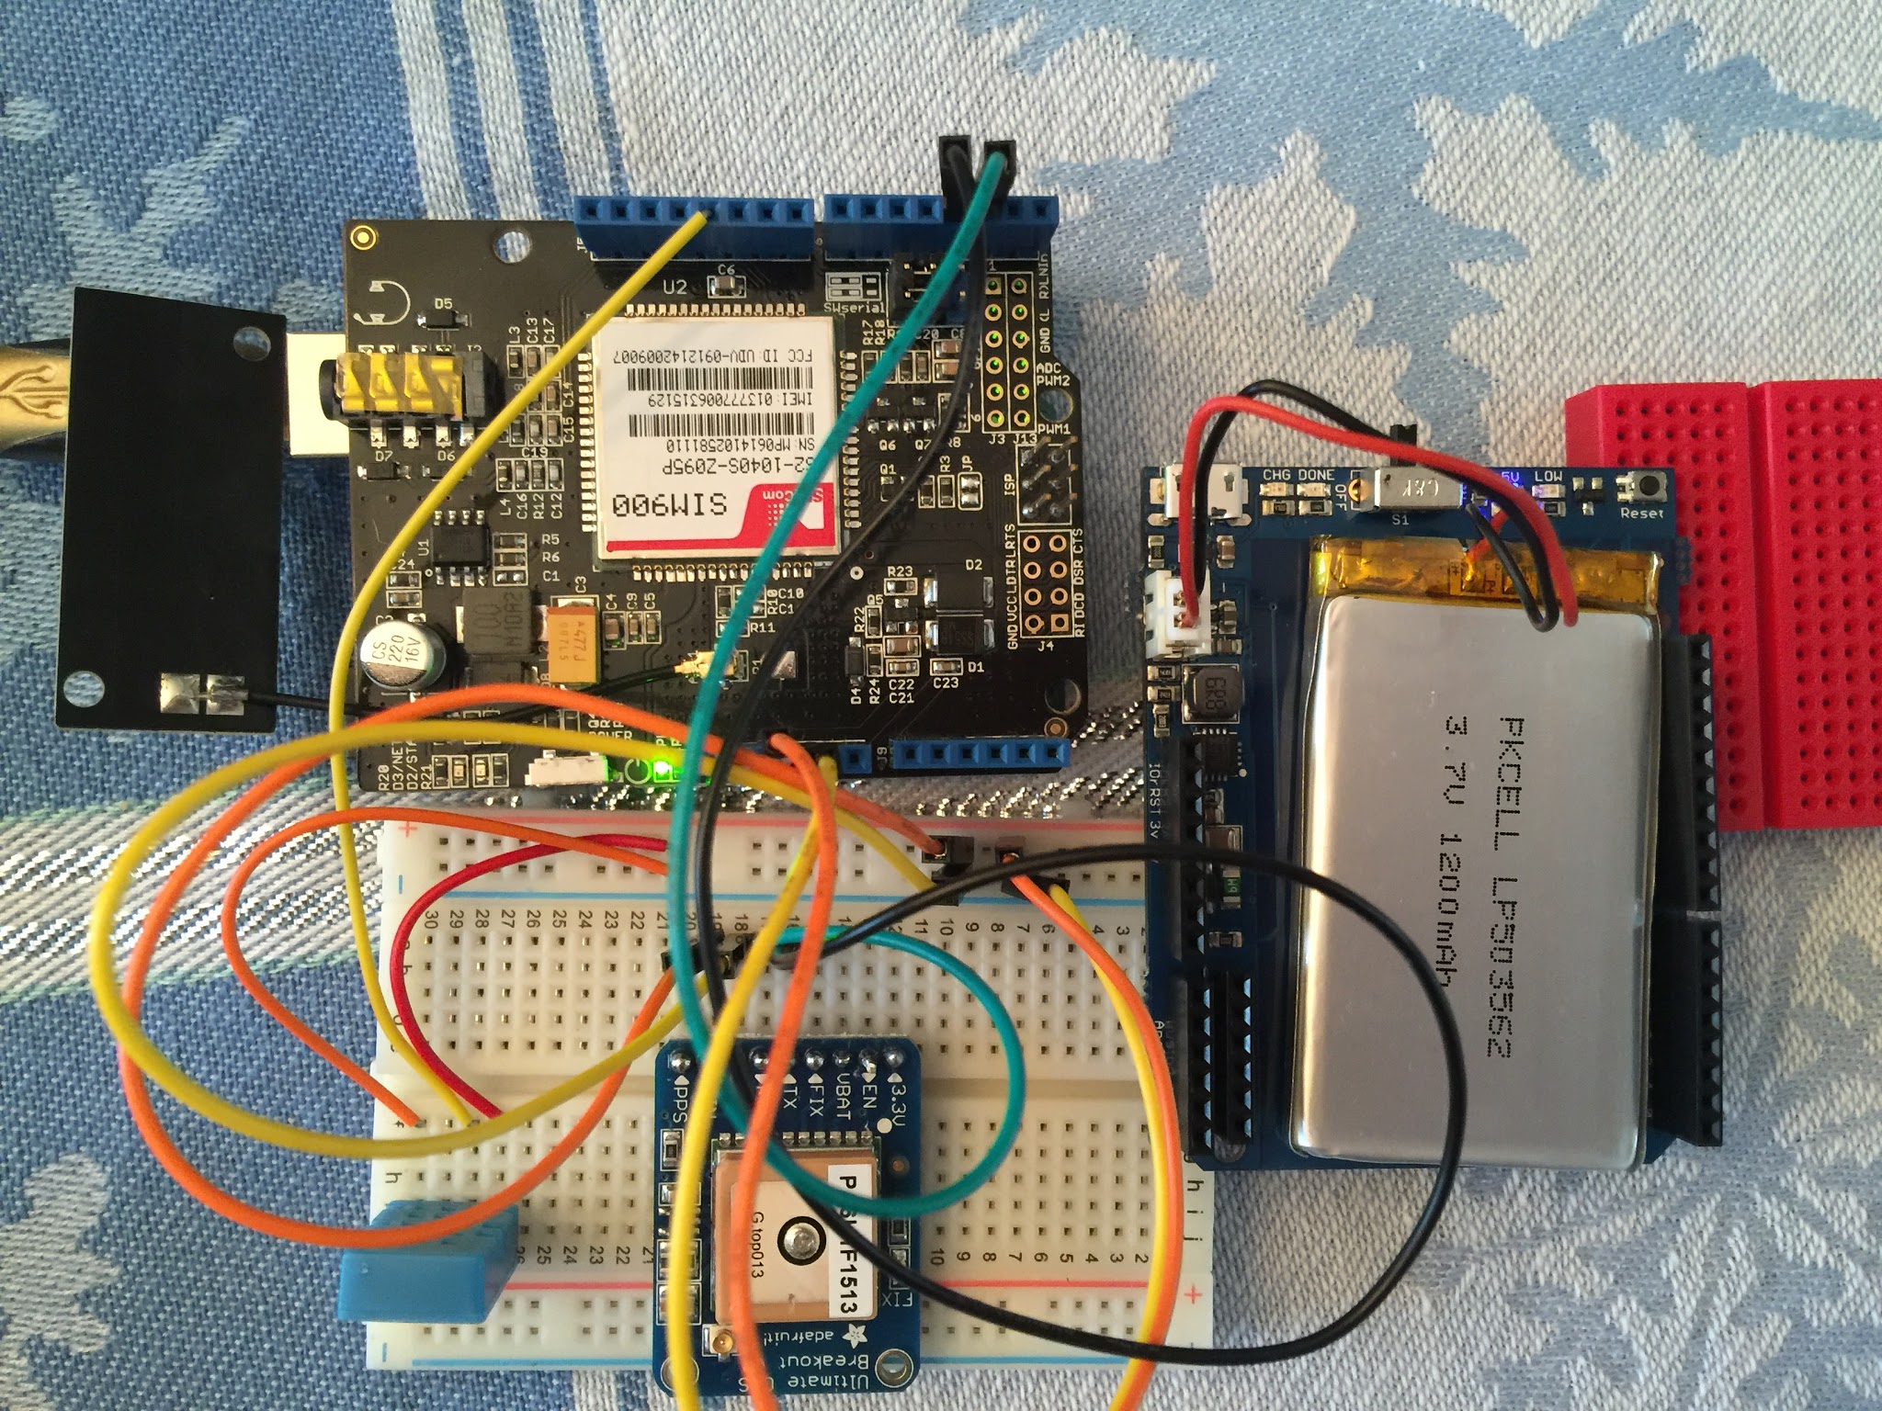
BLACK BOX Components
Technological Aspects
GPS
Weather Monitoring
Communication
Charging
Heart of Device
Durability

Slide 11

GPS
More efficient transportation to safety
Device sends coordinates to server
Server stores the coordinates in the database
Content management system takes coordinates from database and inputs them into google maps.
Easy visual guide for location of homeless persons
Police communications

Slide 12
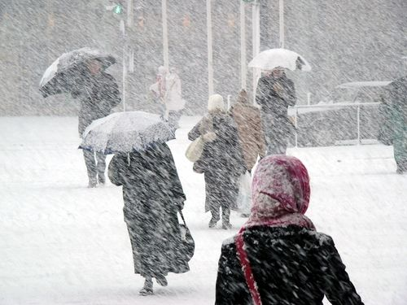
WEATHER CONDITION MONITORING
Prototype equipped with temperature sensor
Barometer and thermometer
Detects outside temperature and sends coordinates if below 32°F
Helps conserve power
Automatically detects Code Blue situations

Slide 13
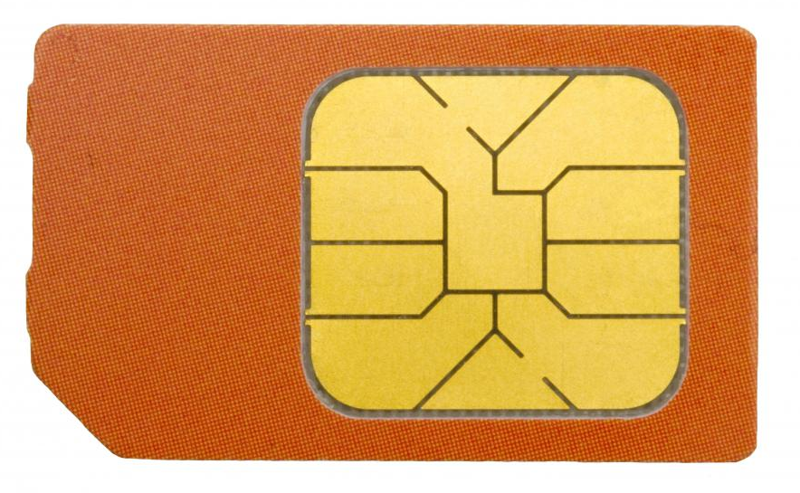

SIM CARD
Allows information to be transferred from arduino to the server
Functions whenever it can acquire a satellite fix

Slide 14

RECHARGING
the device currently has an 8 hour battery life.
if run continuously
will only use power when it detects 32℉ or below temperature
It must be charged by a direct USB connection.

Slide 15
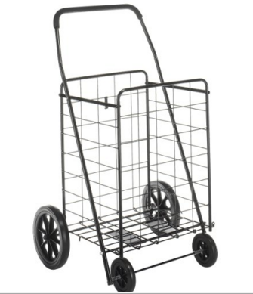
DESIGN PLANS
The base - a folding cart
Durable epoxy coated steel frame
21” x 24.5” x 40.1”
Removable waterproof fabric bag liner
18” x 15” x 24”
bottom of the cart - prototype encasement
7” x 5” x 3”

Slide 16
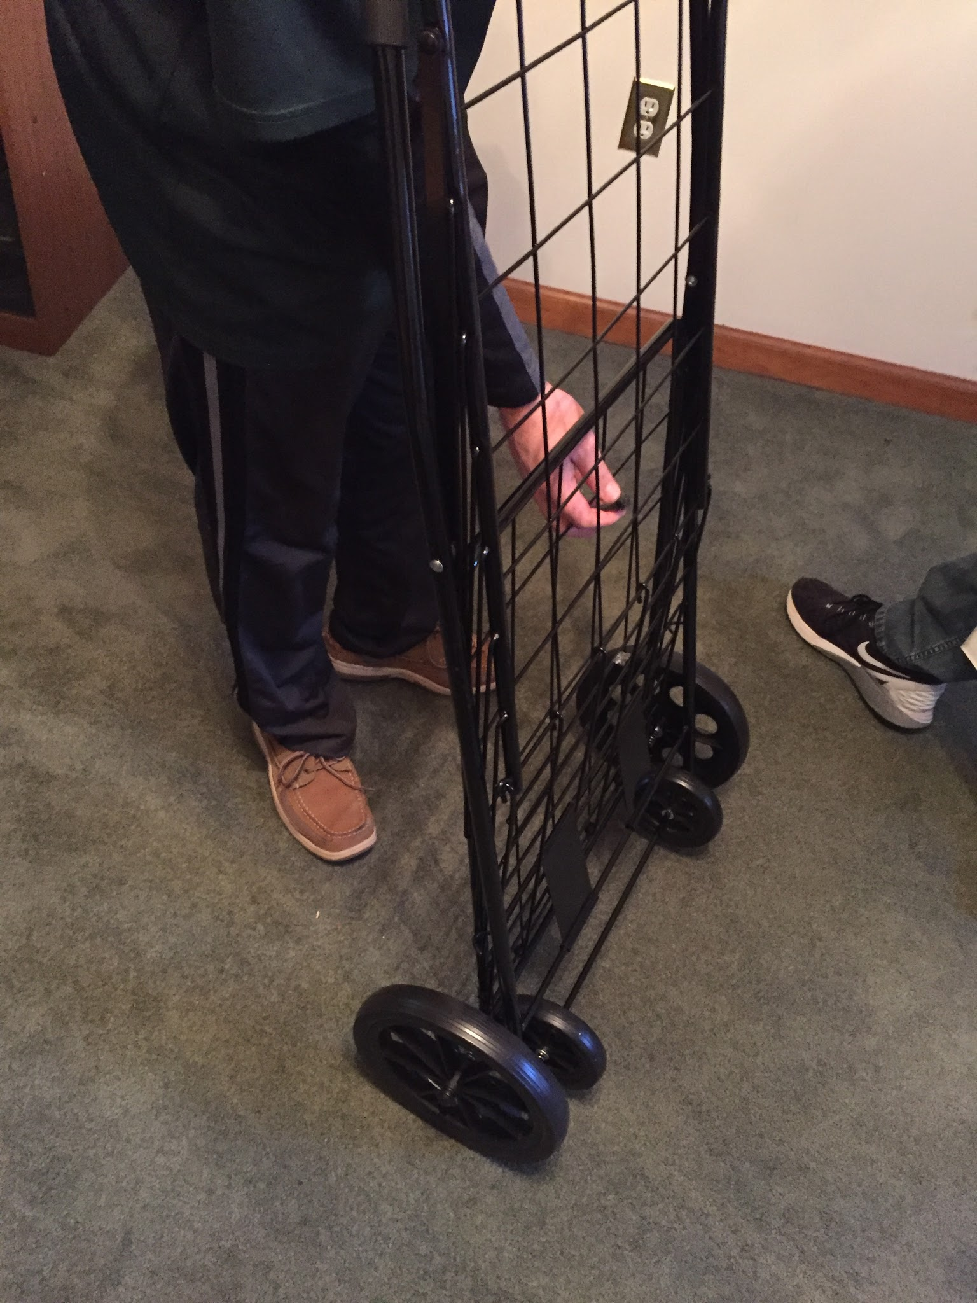
CART FEATURES
Foldable
Durable
Maneuverable
All Terrain
wheels - plastic with rubber tread

Slide 17
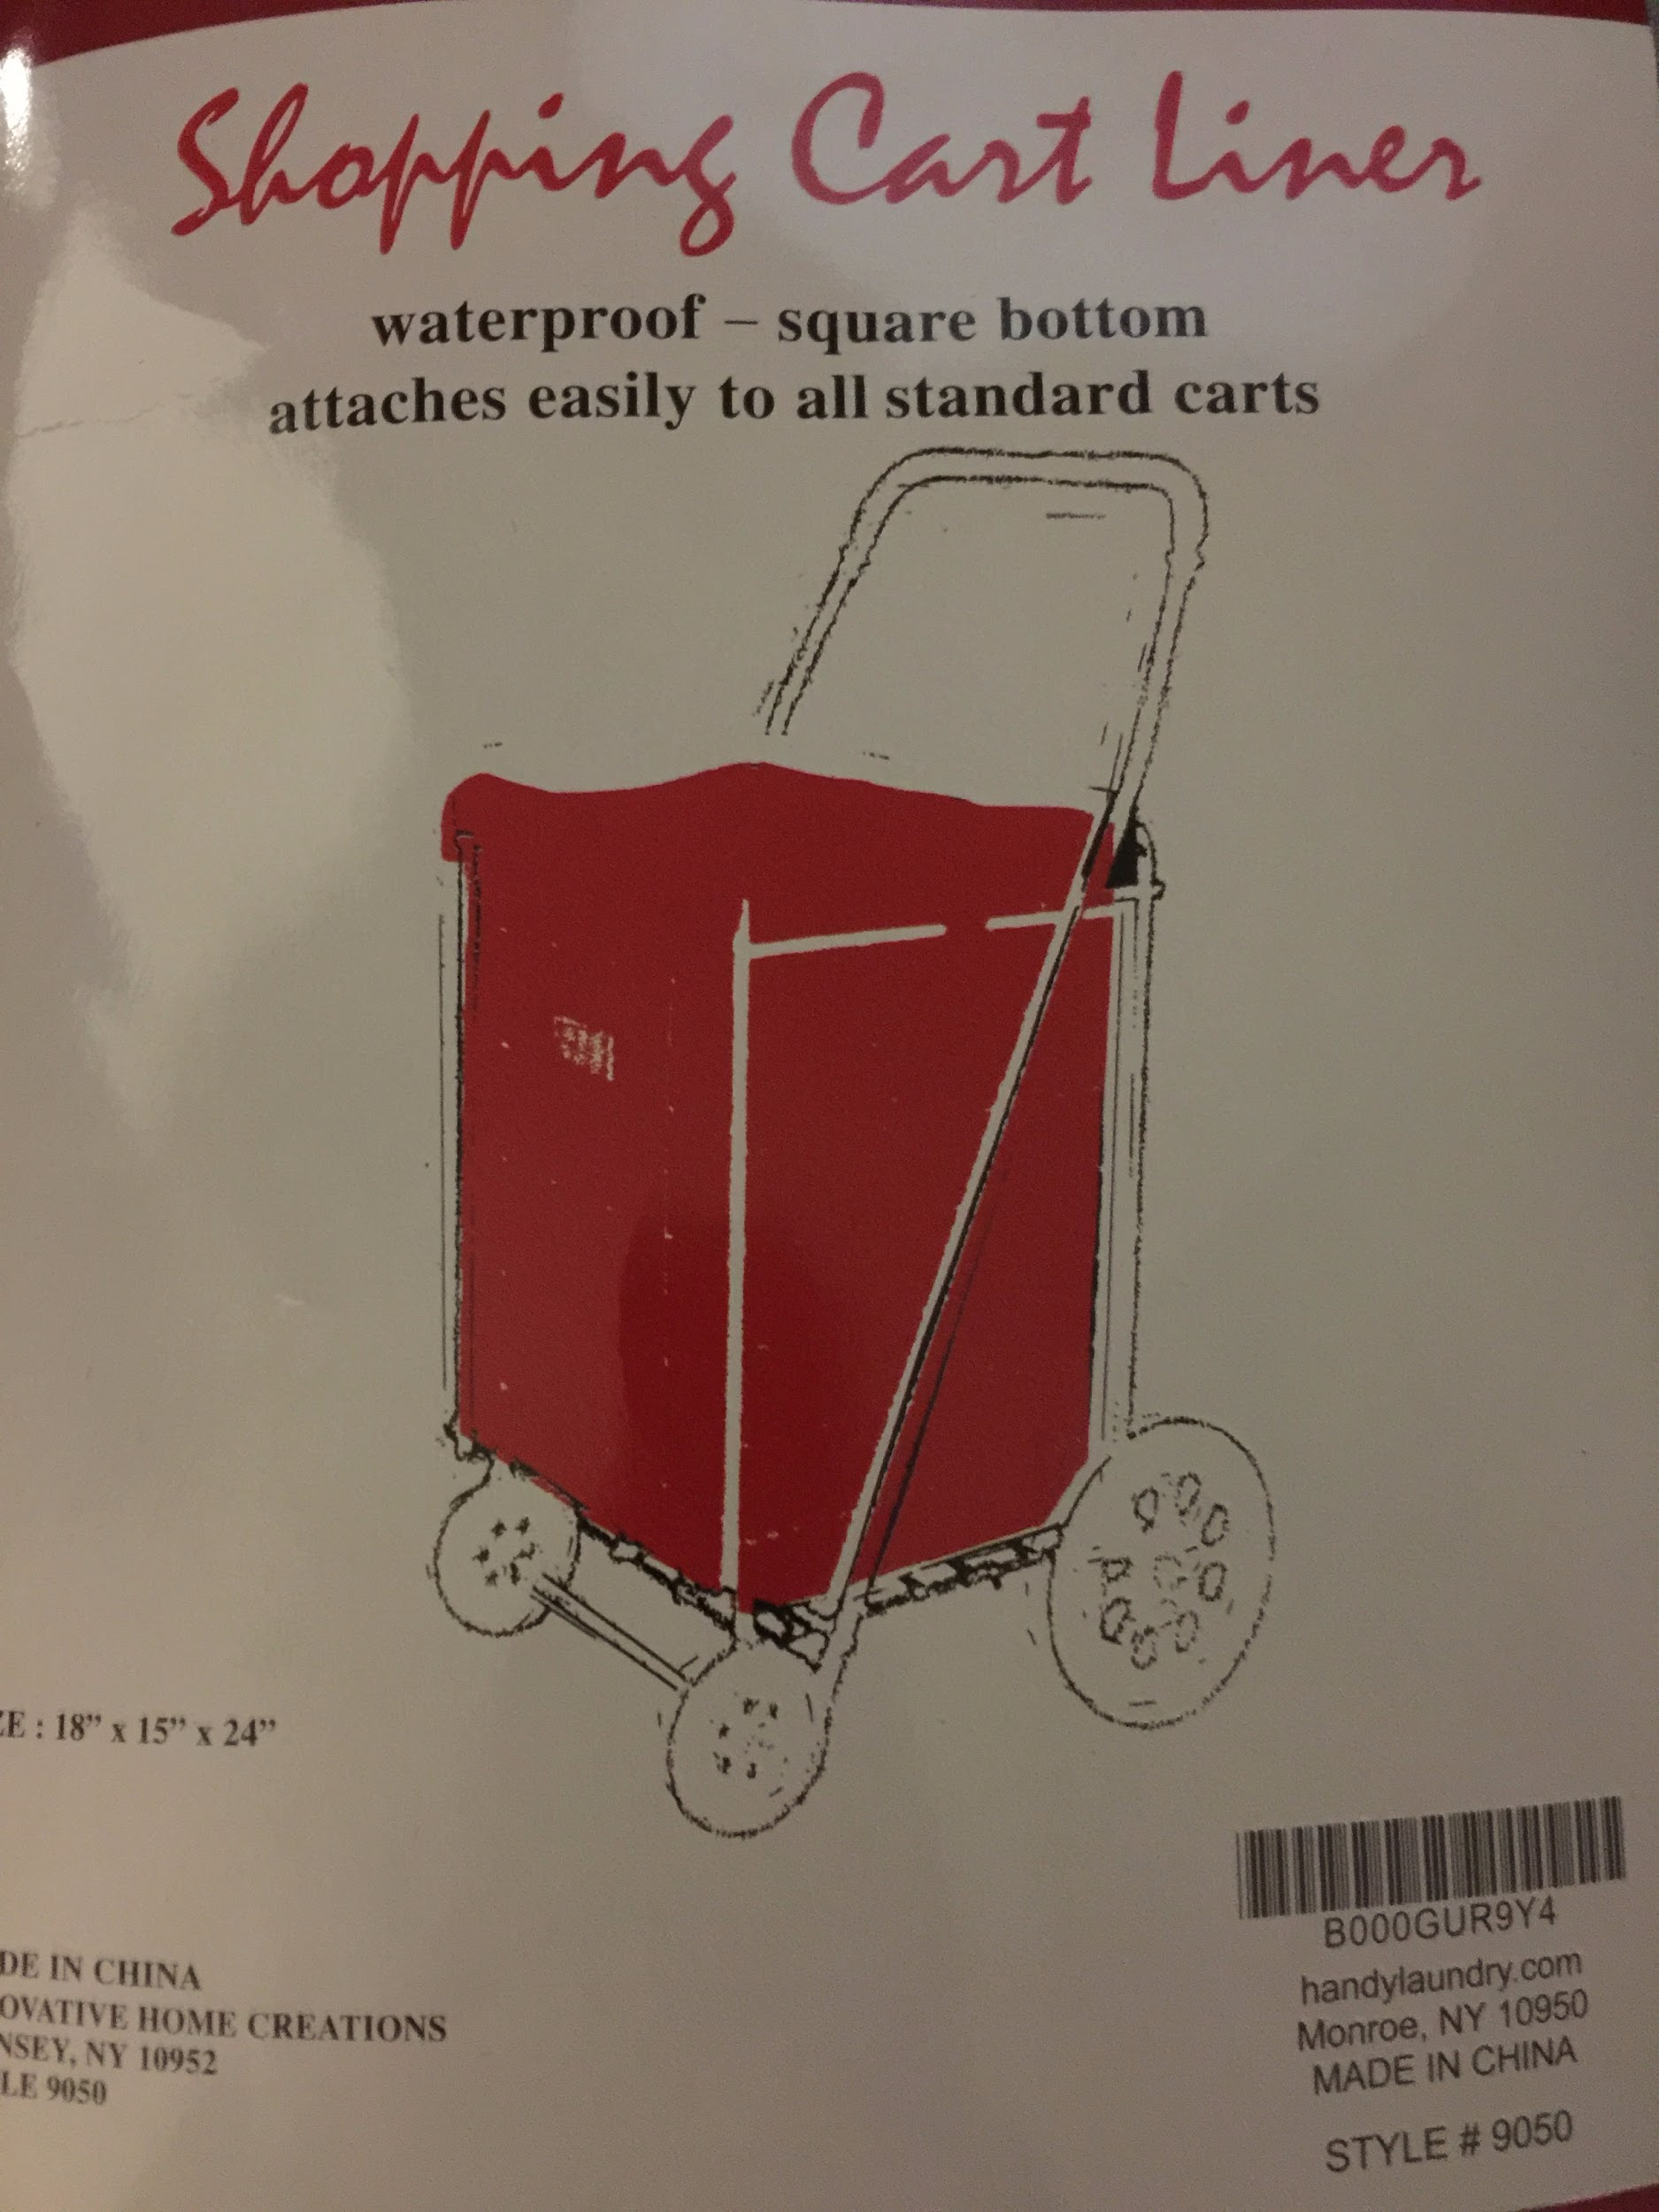
REMOVABLE CART LINING
Velcro lining
Removable
Carrying option - transport
replaceable
Waterproof

Slide 18

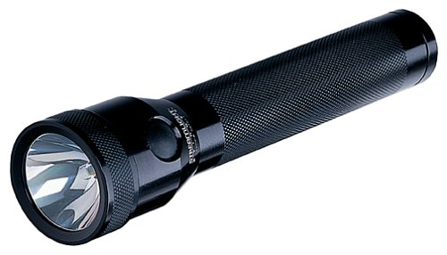

ADDITIONAL CUSTOMIZATIONS
Reflectors
simple, effective way to reduce night time accidents
Flashlight
First Aid Kit
Treat minor injuries and prevent complications
Hand Warmers
Blanket

Slide 19
PUTTING IT ALL TOGETHER
Entire Device: GPS locating, weather monitoring, communication and connectivity device implemented in a versatile and useful cart

Slide 20

CTDI PARTNERSHIP
Communications Test Design Inc
1334 Enterprise Dr, West Chester PA
(610) 436-5203

Slide 21

SAFE HARBOR OF CHESTER COUNTY PARTNERSHIP
Safe Harbor of Chester County
20 N Matlack St, West Chester, PA 19380
(610) 692-6550

Slide 22

DECADES TO DOORWAYS PARTNERSHIP
Decade to Doorways
601 Westtown Rd., Suite 365, West Chester, PA 19380
(610) 344-6900

Slide 23

CONNECTPOINTS PROGRAM PARTNERSHIP
ConnectPoints
Rei Horst, ConnectPoints Program Director
(610) 696-1999 x142

Slide 24

COVENANT HOUSE PA
Covenant House
31 E Armat St., Philadelphia, PA 19144
(215) 951-5411

Slide 25

AMERICAN CIVIL LIBERTIES UNION OF PENNSYLVANIA
ACLU of PA
1401 John F Kennedy Blvd., Philadelphia, PA 19144
(215) 592-1513

Slide 26

STEM SKILLS NEEDED
Autodesk Inventor Skills
Computer Engineering Skills
Electrical Engineering Skills
Materials Engineering Skills
Mechanical Engineering Skills
Legal Application Skills
Statistics Skills

Slide 27
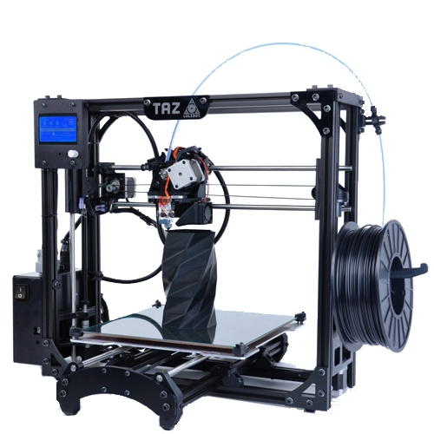
FUTURE IMPROVEMENTS
Creation of custom cart from scratch
Circuit board replacing components and wiring
Convert device to wearable fabric band
Sturdier prototype encasement
Advanced power saving techniques
Addition of panic button

Slide 28
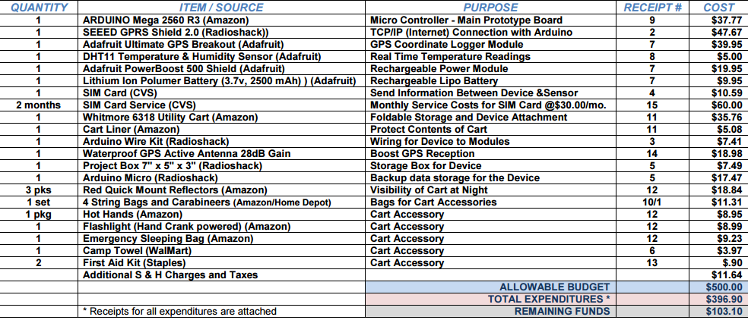
BUDGET

Slide 29
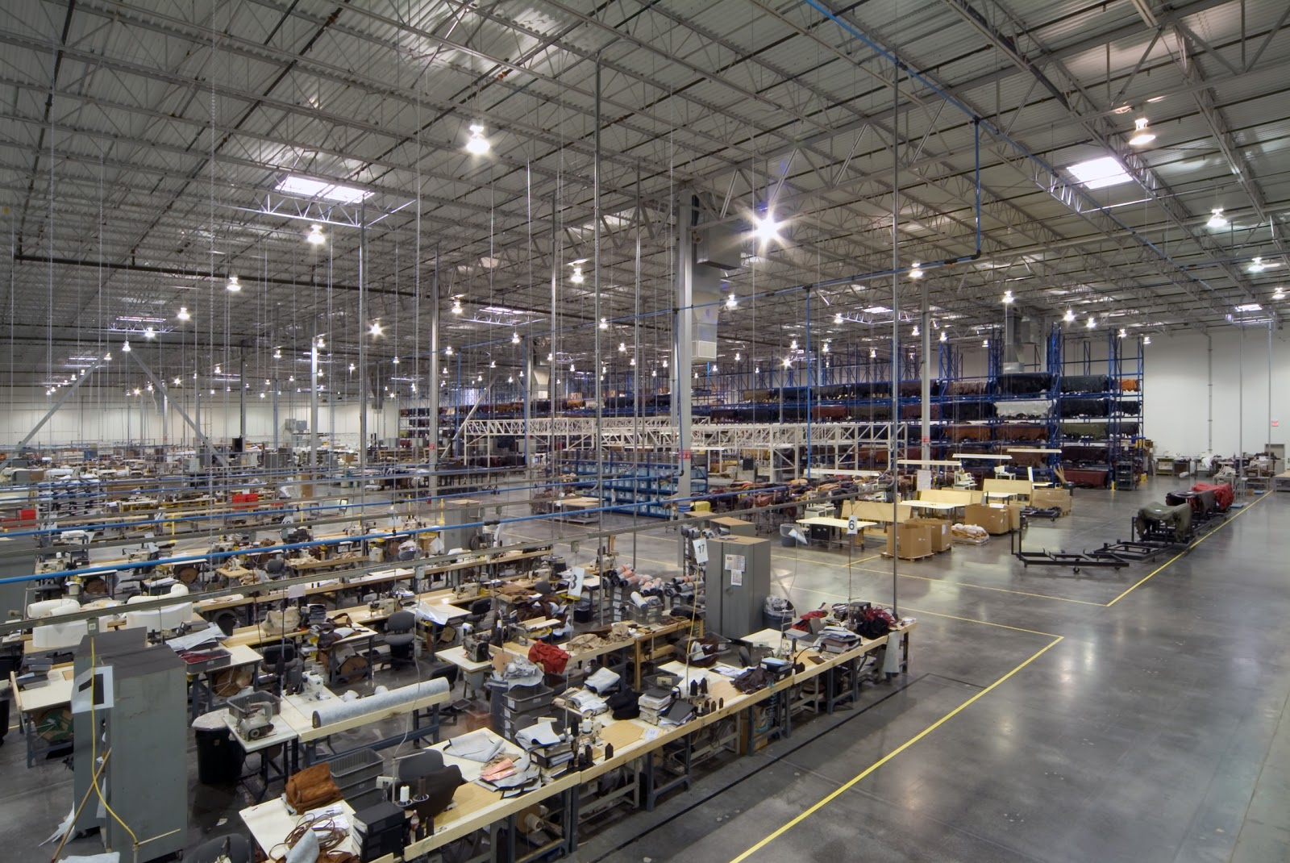
MASS PRODUCTION
3D Computer Model
Agreement with cellular company for lower cost sim card service
Consolidation of device into mass-producible chip
Business sponsorships
Factory production of carts

Slide 30
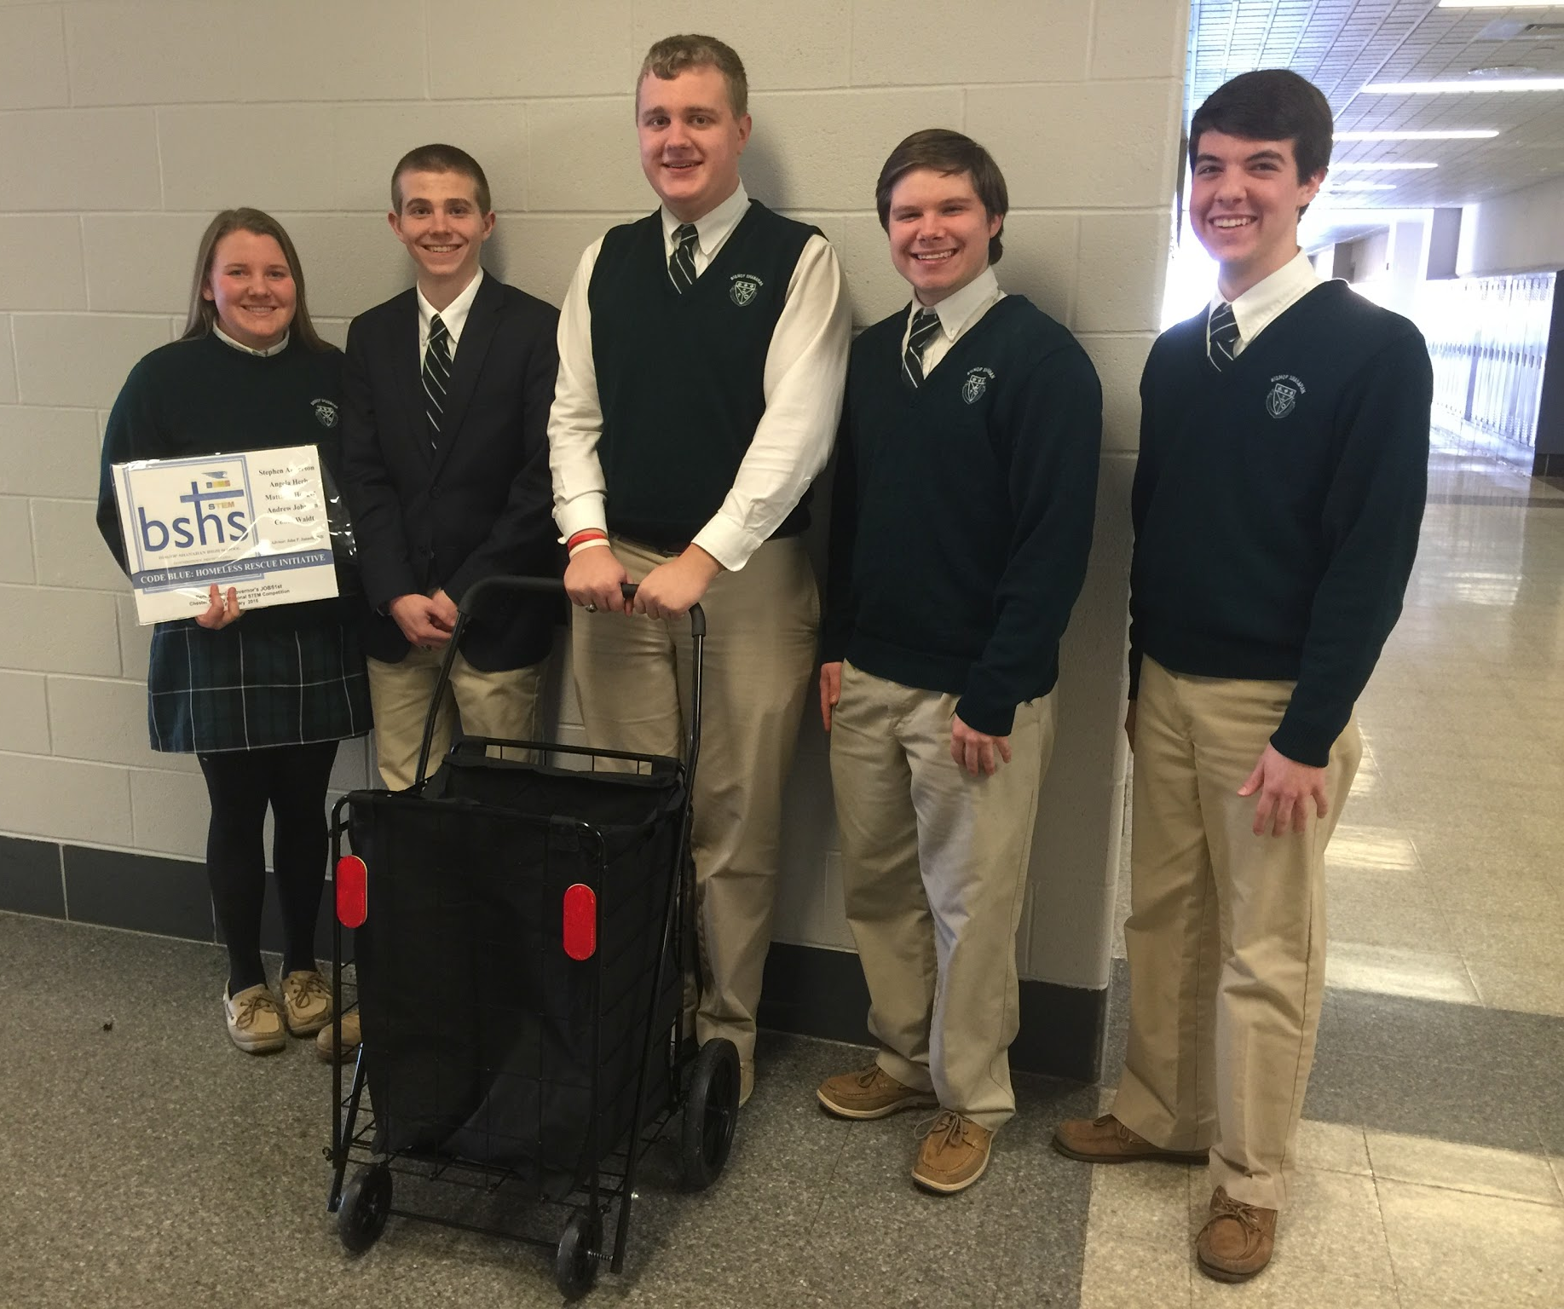
TEAM REFLECTION
Matthew Horger - Team Leader/ Lead Programmer
Angela Herb - Head Communicator
Stephen Anderson - Presentation leader/ Editor
Conor Waldt - AutoDesk Designer
Andrew Johnson - Material Designer

Slide 31
CODE BLUE: HOMELESS RESCUE INITIATIVE
Stephen Anderson, Angela Herb, Matthew Horger, Andrew Johnson and Conor Waldt

